Slide 1




LAPTOP
DATASET ANALYSIS
Student: MOVIRAJ D
Course & Batch: [DA-DS], [MAY-RP36]
Date: 21-07-2025
PAGE 01

Slide 2

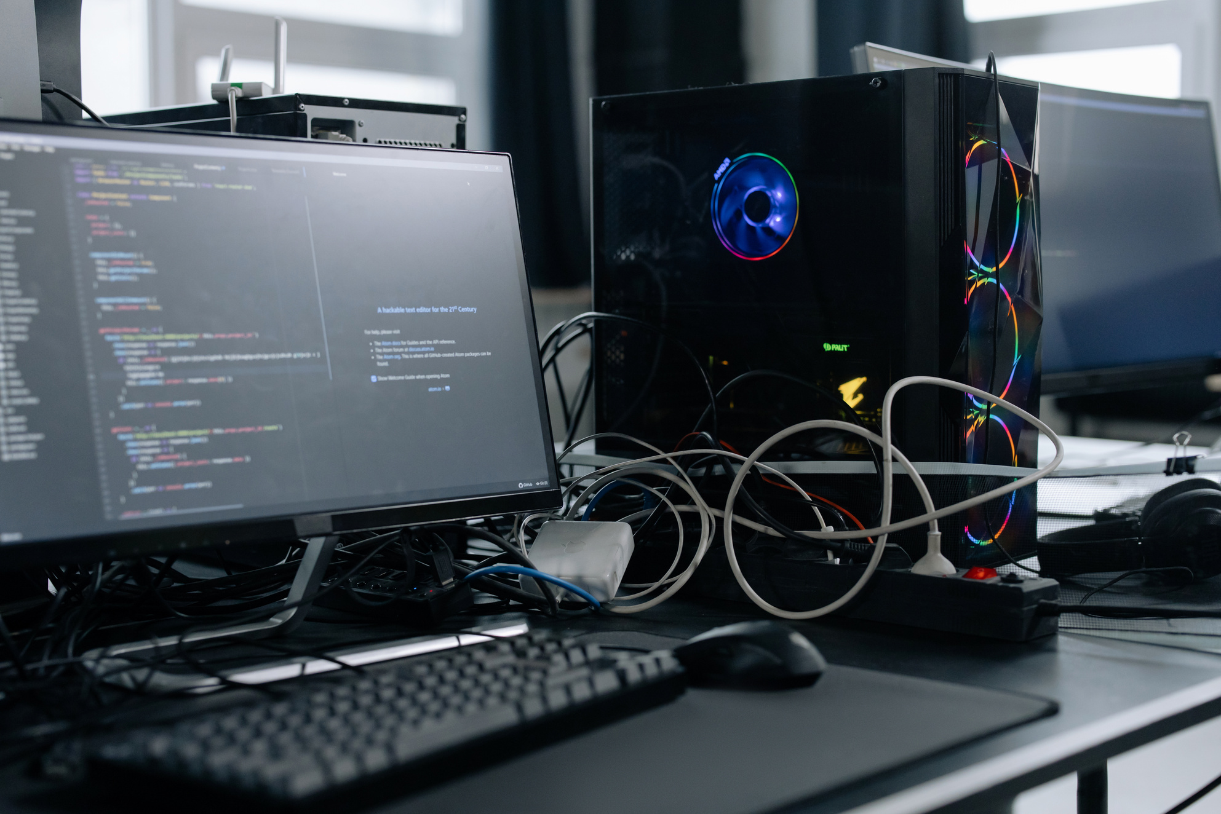
Introduction
The project focuses on analyzing laptop data to understand key patterns and trends.
Objective
To gain insights from the dataset and perform a comprehensive data analysis process including cleaning, visualization, and statistical evaluation.
PAGE 2

Slide 3


Data Understanding
Dataset: Laptop dataset.
Source: Provided for academic purposes.
Key Attributes: Brand, Processor, RAM, Storage, GPU, Price, etc.
PAGE 3

Slide 4

Data Cleaning
Purpose:
Improve data quality and ensure accurate analysis.
Steps
Handling Missing Values
Handling Outliers
Fixing Inconsistent/Invalid Data
PAGE 4

Slide 5
Handling Missing Values
Approach:
Identified missing values using [.isnull().sum().]
Used mean imputation for numerical values
Mode imputation or deletion for categorical values
Handle them using:
Drop rows/columns if too many values are missing.
Fill missing values with mean, median, mode, or forward/backward fill.
PAGE 5

Slide 6
Outlier Handling
Identified using:
Boxplots
Z-score method
Detect outliers using:
Boxplot
IQR (Interquartile Range) method
Remove or cap/floor extreme values.
Q1 = df['Price'].quantile(0.25)
Q3 = df['Price'].quantile(0.75)
IQR = Q3 - Q1
df = df[~((df['Price'] < (Q1 - 1.5 * IQR)) |
(df['Price'] > (Q3 + 1.5 * IQR)))]
PAGE 6

Slide 7

Handling Invalid Values
Checked for negative prices, invalid RAM sizes, etc.
Standardize inconsistent formatting (e.g., "i5" vs "I5").
Replaced or removed based on logical domain understanding
Remove duplicates: df.drop_duplicates()
Fix data types: e.g., convert strings to integers.
PAGE 7

Slide 8
Exploratory Data Analysis[EDA]
--
--
--
Univariate Analysis
Multivariate Analysis
Bivariate Analysis
Goal: Understand the distribution and basic statistics of individual columns
Visuals: Histogram, Boxplot
Interpretation: Most laptops fall within a mid-range price bracket
Goal: Explore relationships between two variables.
Visuals: Scatter Plot
Interpretation: Positive correlation observed
Goal: Analyze interactions between three or more variables to uncover deeper patterns.
Techniques: Pairplot, Heatmap
Examined relationships between RAM, Processor, and Price
PAGE 8

Slide 9
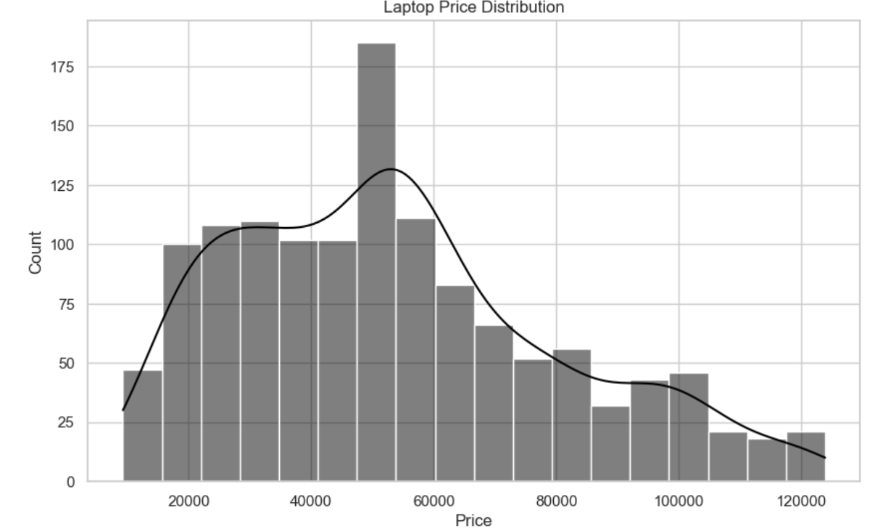
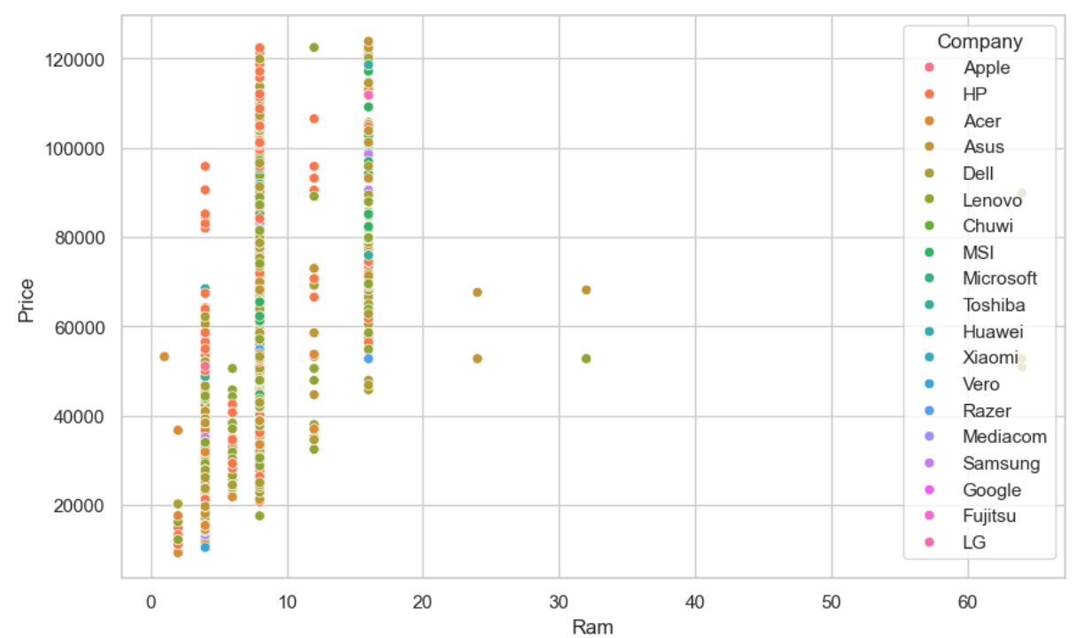
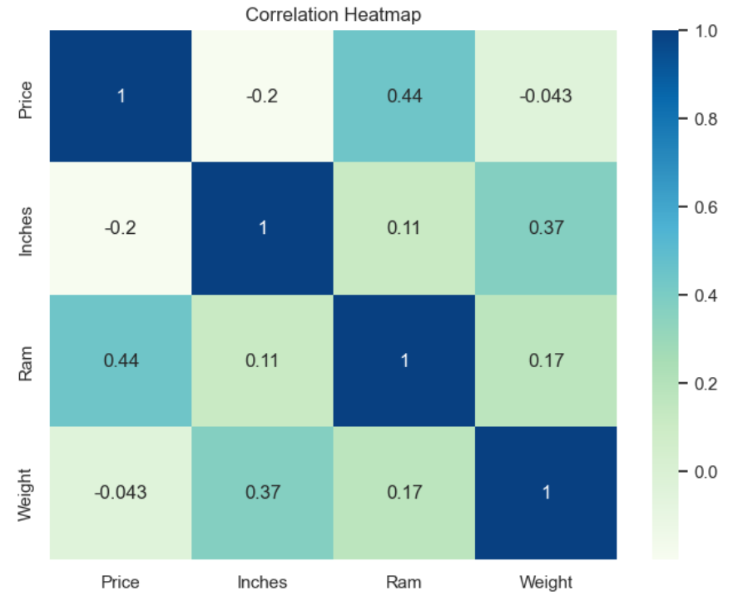
Data Visualization
Importance: Simplifies complex data
It create a visualizations to illustrate trends, preferences, and market dynamics in the laptop industry.
PAGE 9

Slide 10
FUTURE ENGINEERING
⿡ Extract CPU brand and generation to better group laptops by performance level.
⿢ Flag SSD vs HDD to highlight impact of fast storage on price.
⿣ Categorize weight (light vs heavy) to separate ultrabooks from gaming laptops.
⿤ Group brands by reputation (premium vs standard) to see how brand image affects pricing.
⿥ Create new features like screen resolution quality (e.g., Full HD, 4K) for deeper price trend insights.
PAGE 10

Slide 11

INSIGHTS
RAM and CPU brand are top price influencers.
Ultrabooks and Gaming laptops are costlier.
Brand reputation significantly impacts pricing.
Weight and Screen size are moderately correlated.
Intel i7 and dedicated GPUs increase price significantly.
PAGE 11

Slide 12
Conclusion and Recommendations
Key Findings:
RAM and processor type significantly impact price
Some brands offer better value-for-money
Recommendations:
Focus on mid-range laptops for cost efficiency
Further analysis on GPU and gaming performance
Future Work:
Include customer reviews
Use ML models for price prediction
PAGE 12

Slide 13
THANK YOU!
Thank you for exploring laptop dataset analysis
PAGE 13

